Slide 1
Sugar CRM
www.sugarcrm.com

Slide 2
What is CRM?
Customer Relationship Management
Refers to practices , strategies and technologies that companies use to manage and analyze customer interactions.
CRM Software includes customer information and records into a single CRM Database so business users can easily access and manage it.

Slide 3
Sugar CRM
World’s Largest open source CRM software with 7000 customers and millions of users .
Founded in 2004.
Sugar’s open platform easily solve real business problems.
Sugar gives you the tools that empower every
customer _facing individual to create extra-ordinary customer relationship.

Slide 4
Why Sugar CRM?
Makes CRM easier
Faster Accessibility
Easily find the information that user needs
Display information on single screen
Saves Time

Slide 5
What you need to install Sugar CRM?
All you need to get going is the following software stack:
A Web Server (Apache )
A Database (Mysql,DB2,Oracle)
Web Browser

Slide 6
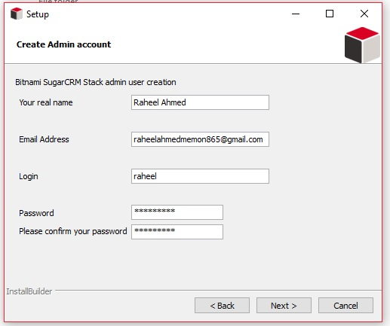
Admin Account

Slide 7
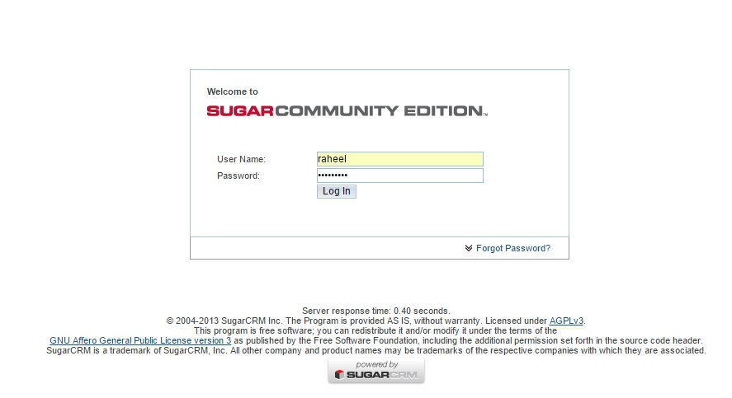
Login Screen

Slide 8
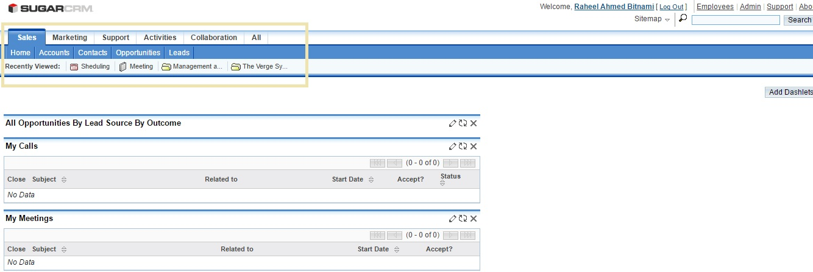
Home Screen

Slide 9
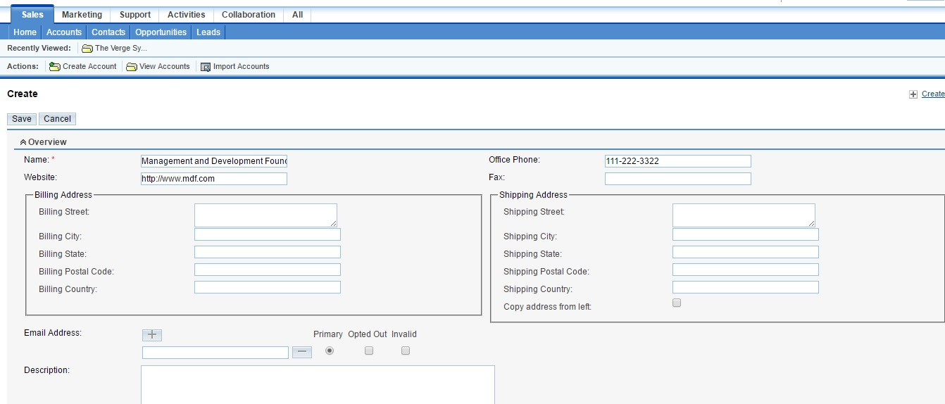
Creating Company Account

